Slide 1

Group Members: Arslan Ali 01-243211-002 Shahid Hussain 01-243211-009 Arsalan Akram 01-243202-010
Pedestrian Detection

Slide 2
Introduction
Pedestrian detection is an essential and significant task in any intelligent video surveillance system, as it provides the fundamental information for semantic understanding of the video footages.

Slide 3
Why pedestrian detection Needed?
To detect vulnerable Pedestrian
Safe driving assistant Navigation
To solve pedestrian Traffic & safety
To analyze study & behavior of pedestrians
Balance between pedestrian & vehicle to improve road capacity
Use to monitor parking lots ,stations, shopping malls,bank,sensitive
Save a lot of manpower & material resources

Slide 4
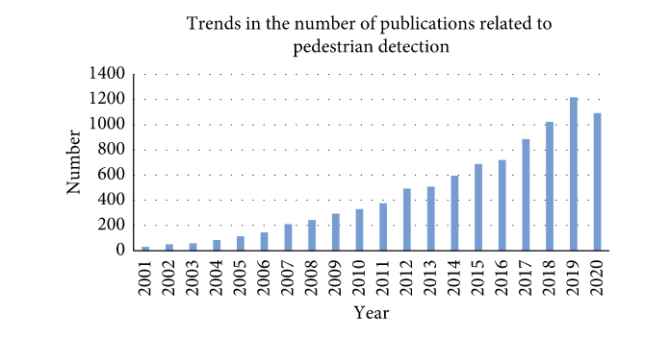
Pedestrian Detection Publications

Slide 5
Methodology
*Pedestrian detection using Monocular vision Concepts
field of view is increased
depth perception is limited
*Monocular vision Steps
Pedestrian Detection system
Pedestrian Tracking system

Slide 6
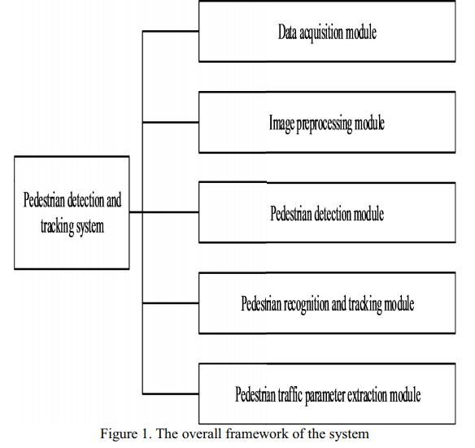
Cont..

Slide 7
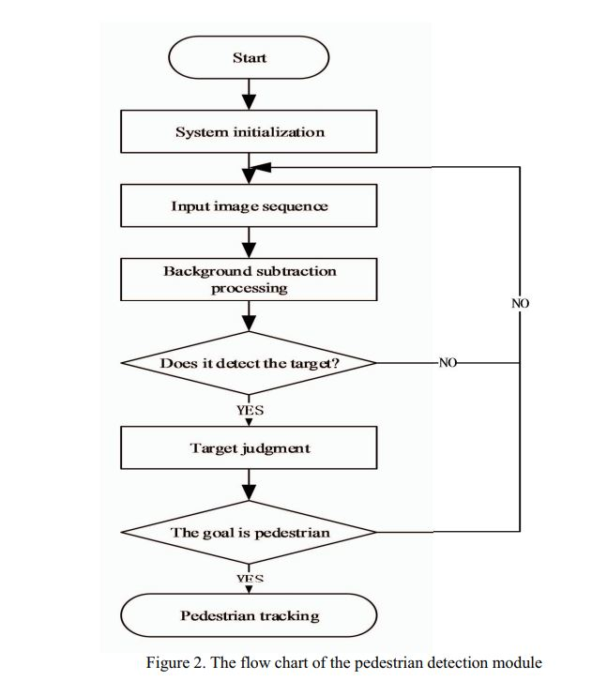
Cont..

Slide 8
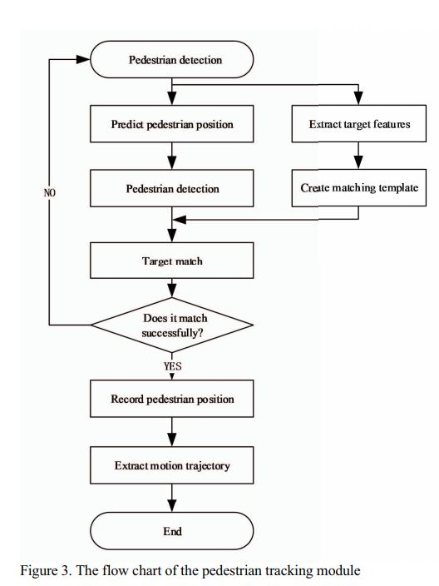
Cont..

Slide 9
Cont
*Thermal-Based Pedestrian Detection
Faster R-CNN
Region Decomposition Branch
*Novel thermal-based system for nighttime pedestrian detection

Slide 10
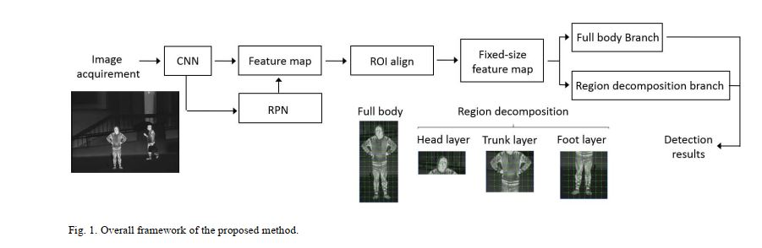
Cont..

Slide 11
Haar-cascade classifier
Haar-cascade classifier
Haar-Feature selection.
Creating integral images.
Adaboost training.
Cascading classifiers.
Haar-features are like convolutional kernels
Integral images are used
Relevant features concept called AdaBoost is used

Slide 12
Haar-cascade classifier and SORT for pedestrian tracking.
Recognize from frame to frame object
Unique ID is assigned
Simple Online and Real-Time (SORT) tracking algorithm
Video stream is taken as input
Instance of the SORT, frames of the video stream and instance of the Haar-cascade
Frames are turned to gray and then apply the Haar-cascade
Apply SORT

Slide 13
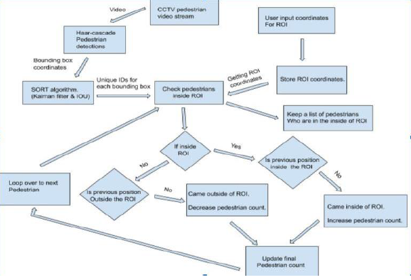
Pedestrian counting
Take input as the coordinates of the detected and tracked pedestrians and ROI
Pedestrian counting module

Slide 14
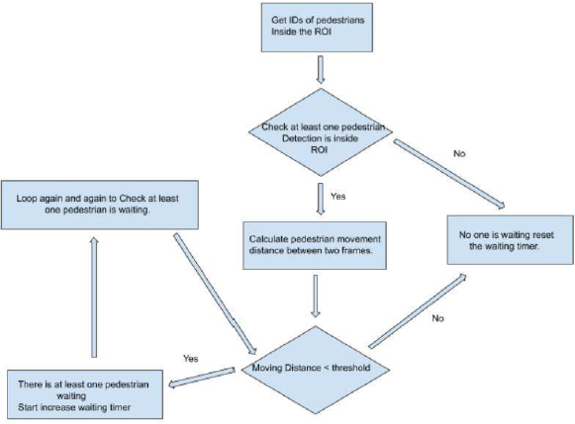
Waiting time calculation
IDs of pedestrians who are inside the ROI is used
Pedestrian movement distance between two frames
Will be checked against a threshold distance.

Slide 15
Limitations
Tend to be prone to false-positive detections
One by One detection and count.
Not as accurate as the more “modern” algorithms we have today

Slide 16
Conclusion
The proposed technologies are ideal to detect pedestrian for real time applications as well as to detect the moving pedestrian from fixed scene & track the movement of pedestrians. After applying those techniques pedestrian speed, their waiting time, vulnerabilities , and movement can be monitored which is very essential in this populated world.

Slide 17
Future work
Detection part can be improved
Quantum technologies can be used to increased speed and accuracy .
Voting system (highest number of pedestrian on location)

Slide 18
References
Pedestrian Detection,Tracking,Counting,Waiting Time Calculation and Trajectory Detection for Pedestrian Crossings Traffic light systems.
Enhanced Vulnerable Pedestrian Detection using Deep Learning
Pedestrian Detection based on monocular vision

Slide 19

Thankyou
Questions & Answers

